Slide 1
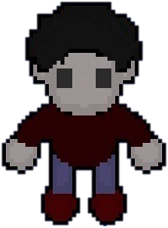
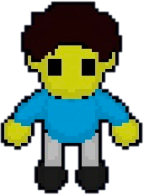
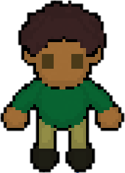
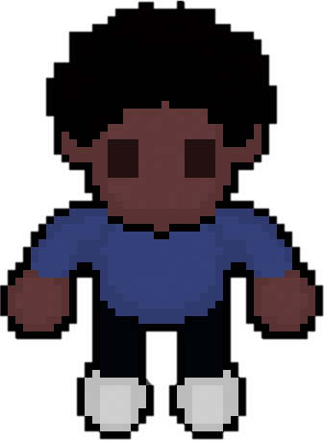
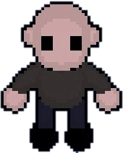
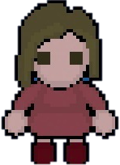
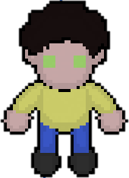
Collaboration Space
Khaled
Assylbek
Daniel
Asian
Ys
Fatma
Amai
Notes:
Title in same font as game
Maybe each make it’s own avatar with the name and take a screenshot

Slide 2
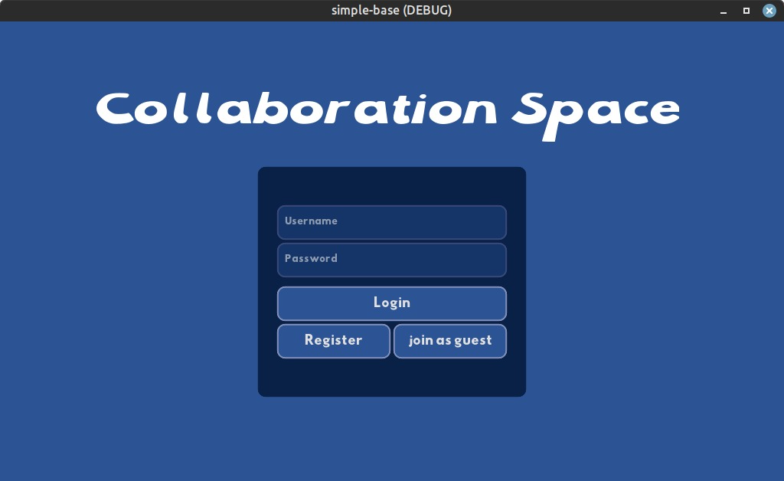
Overview
Project
Introduction
Live demonstration
Reached goals
Technical view
Used technologies
Multiplayer
User management
Chat
Space design/UI
Project conclusion
Retrospective
Outlook

Slide 3
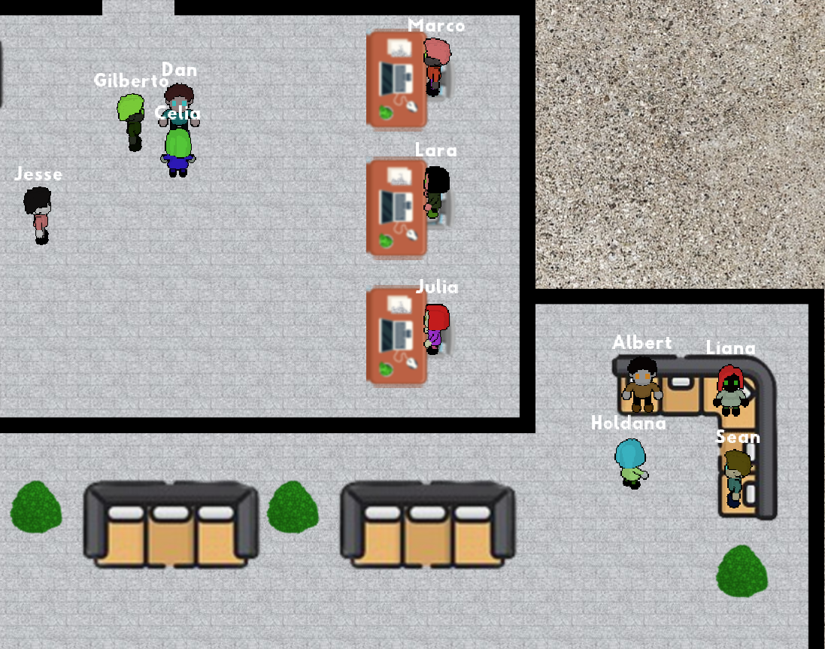
Work

Slide 4
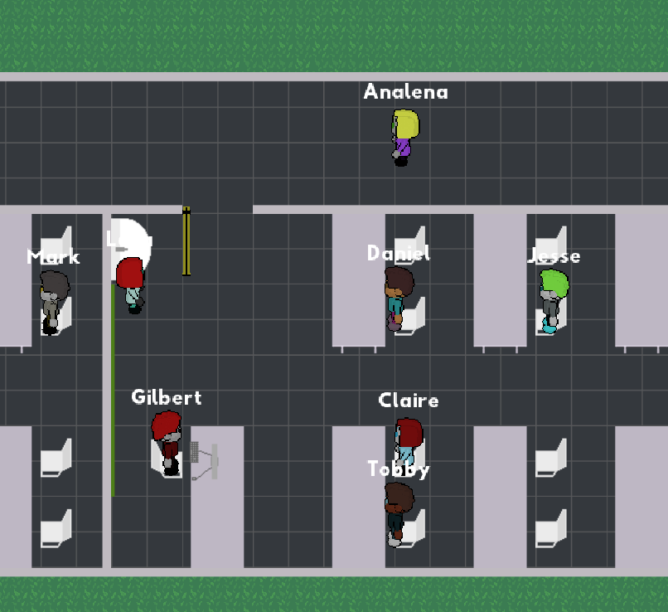
Study

Slide 5
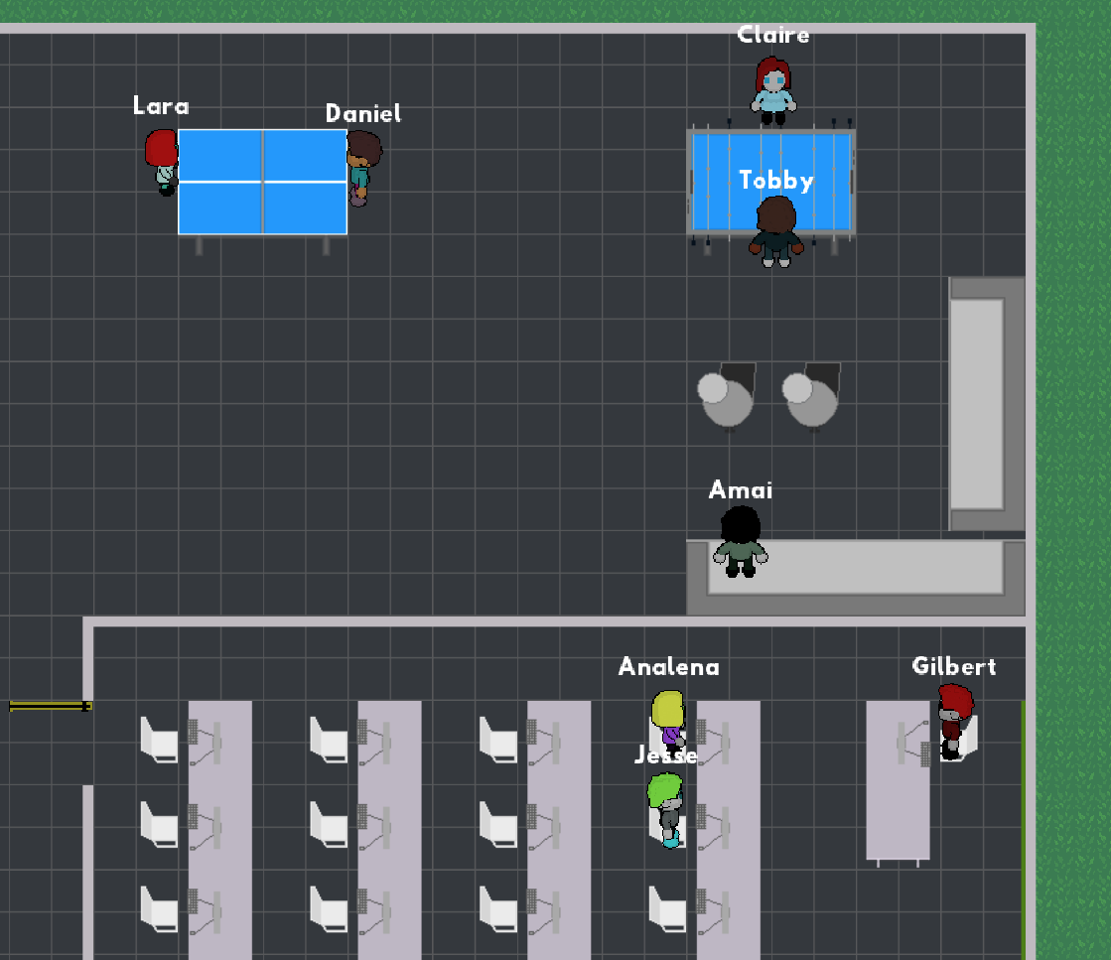
Socialize

Slide 6
1.1 Introduction – client requirements
Allow participants to navigate in a 2D space
Virtual location-based interaction
Synchronous chat
Open project
Vision
Bring the online world a step closer to the real world.

Slide 7
1.2 Project Demo

Slide 8
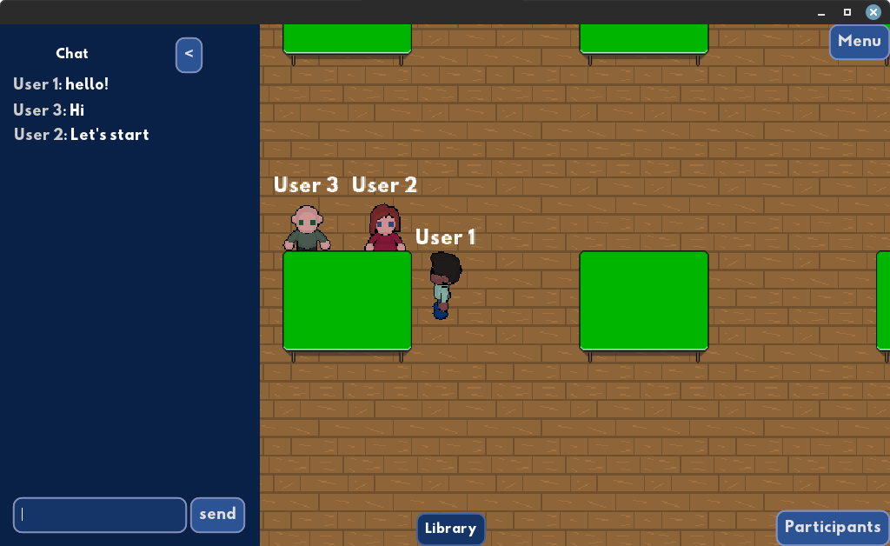
1.3 Reached goals
Multi user
Customizable avatar
Join the spaces online
3 different spaces to join
Interact through chat
Chat history per room
See who is online
See where the users are
Support for multiple platforms
Reactions with emojis
User Authentication

Slide 9


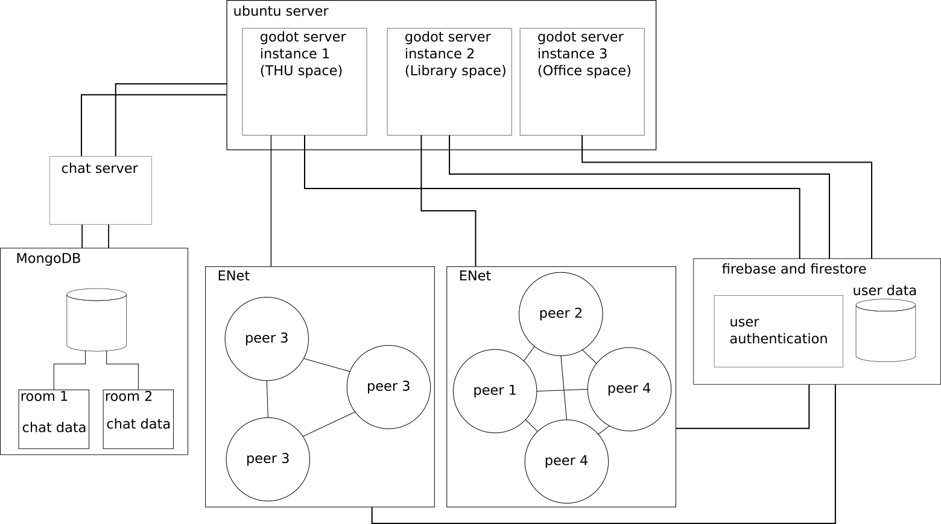













2.1 Used technologies
Notes:
Add any other technology by team members
Is any organisation tool missing?

Slide 10
Chat
text messaging between different users.
WebSocket protocol is used for two-way communication between client and server.
Python Websockets library.
Messaging is allowed depending on rooms.
Client and server communicate messages in JSON format.
{
“type”: “assign_room”,
“user_id”: user_id,
“room”: room,
“state”: “join”
}

Slide 11
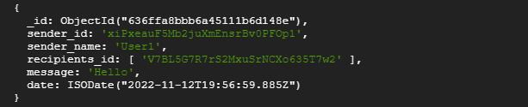
Chat
NoSQL with MongoDB is used to store messages in a database.
Collection corresponds to a room. Document corresponds to a user message.
Python Motor library to handle MongoDB connection.

Slide 12

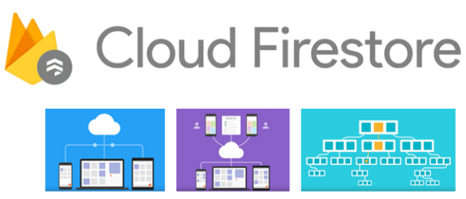
User management
Firebase - for user management Google-backed application is used. From two types of general purpose database services offered by Firebase, "Firestore" was better fit for us in order to store general data. Additionally, Firebase Auth is used to store authentication data.

Slide 13
User management services:
Firebase Auth:
Sign up with email / password
Sign in with email / password
Sign in anonymously
Refresh of session token
Delete account
Change password
Firestore:
Save data – username and avatar configurations saved
Update data- update username and avatar configurations
Get data- get username and avatar configurations
Delete data- Firebase account has to be deleted, alongside with Firestore Database entry

Slide 14
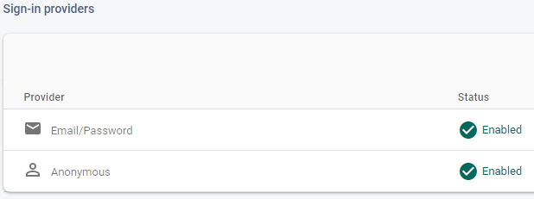
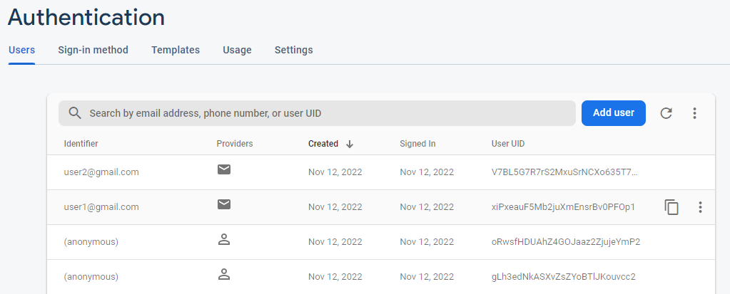
Firebase Auth-authentication of the users, keeps password, UUID and emails saved.

Slide 15
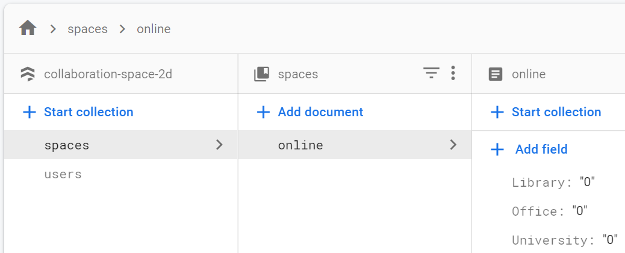
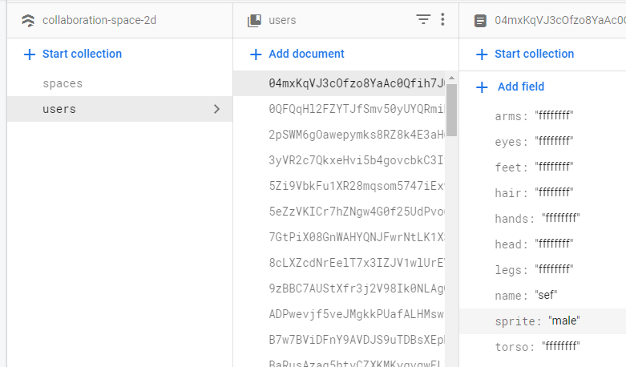
Firestore – database to store any data such as username, avatar configurations, etc.

Slide 16
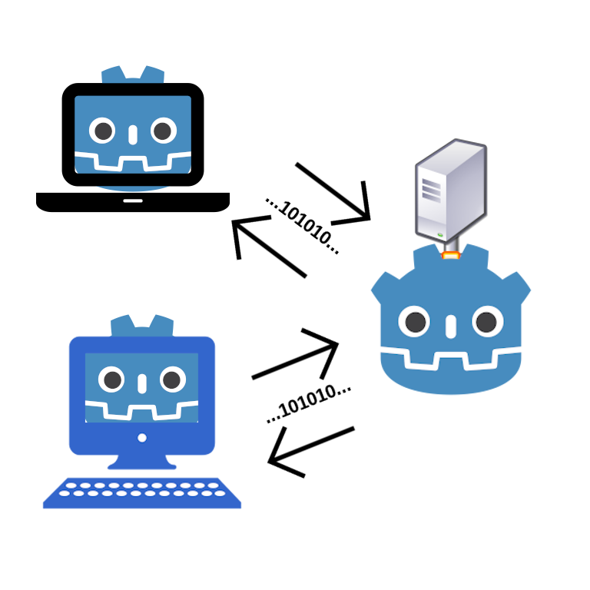
Multiplayer
Network connection
Communication between network peers
Application initialization
Synchronization

Slide 17
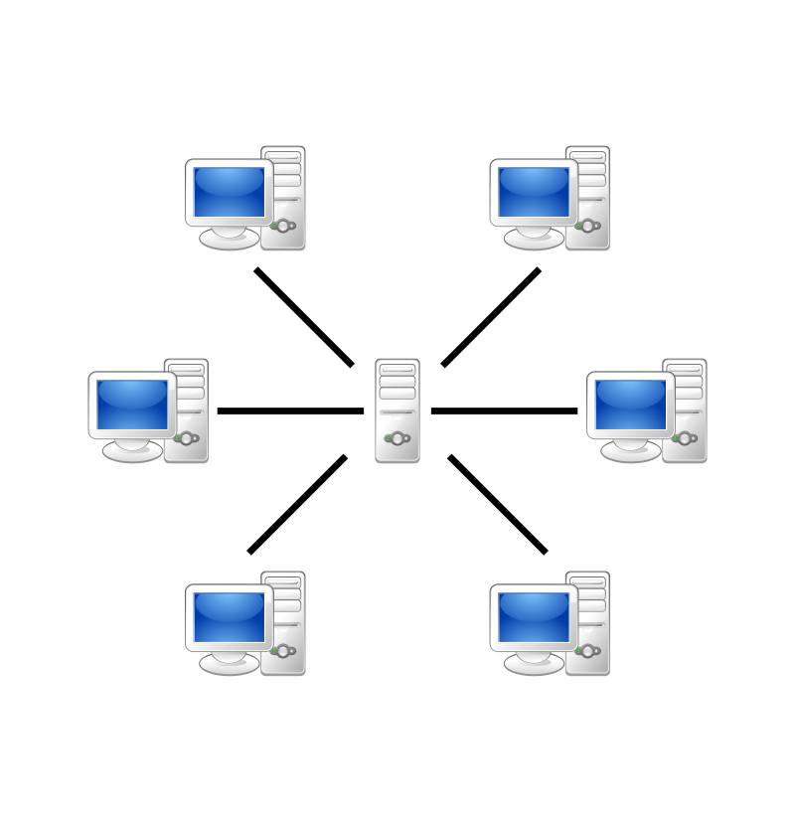
Multiplayer network connection
Server network peer
Acting as application host
Forwards initialization information for new user
Forwards information about new user to users already online
Client network peer
Connects to host
Requests initialization information from server
Receives/sends information for synchronization
Gets informed if user disconnects

Slide 18
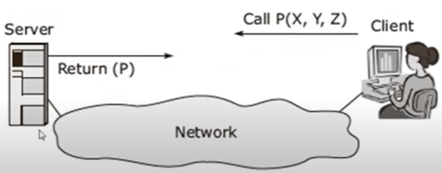
Multiplayer communication between network peers
Communication is performed via Remote Procedure Call ( RPC )
Used to inform about:
user/server connect/disconnect
exchange user/server information

Slide 19
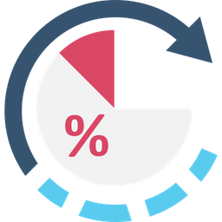
Multiplayer application initialization
Initialization of space
Information is on client-side
Initialization of participants
Adding another participants
Adding yourself
Online participants add new user

Slide 20


Multiplayer synchronization
Participants
Doors
Reactions
Velocity
Current_animation
Current_location
Open
Interaction_active
Current_emoji

Slide 21
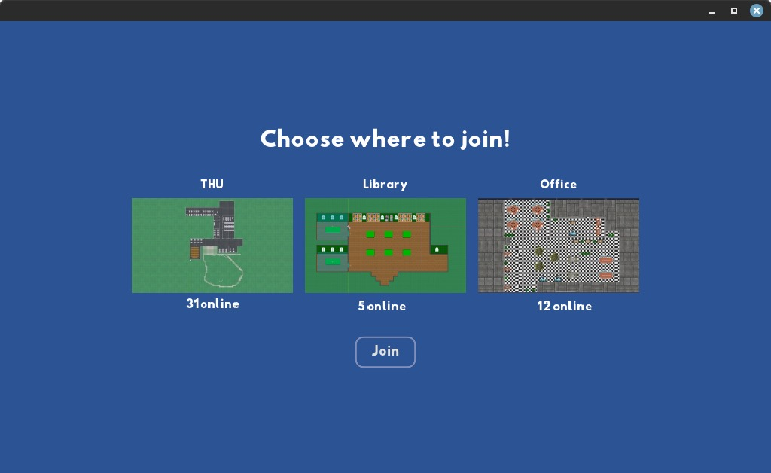
UI
Custom global theme using Godot's theme editor
Scene Transition
Godot's change scene function
Godot's hide and show function

Slide 22
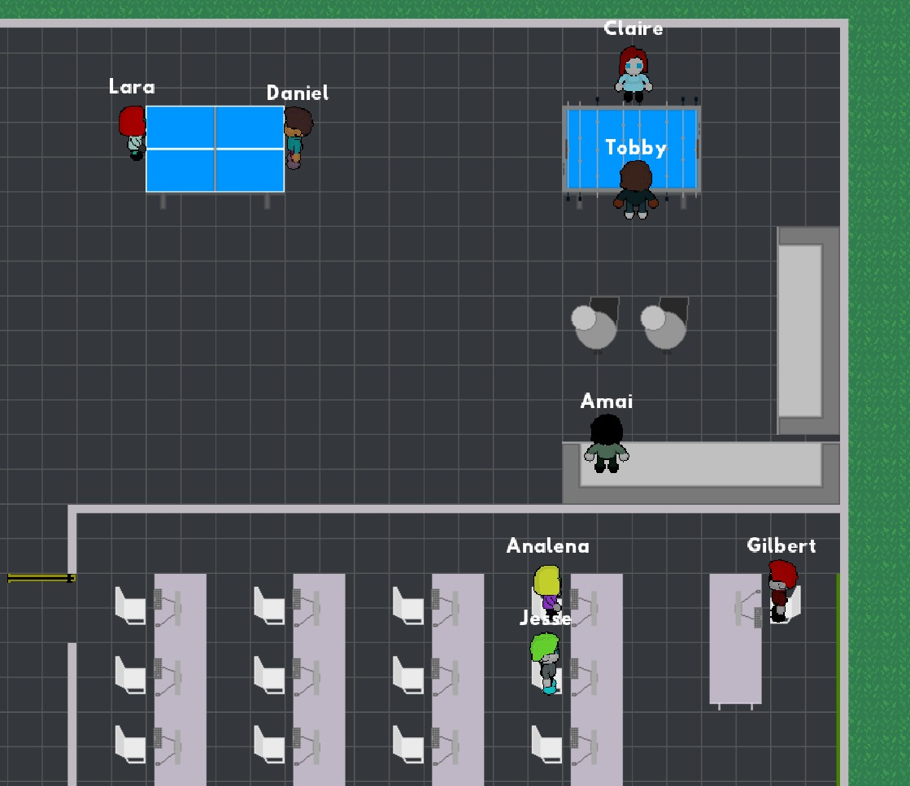
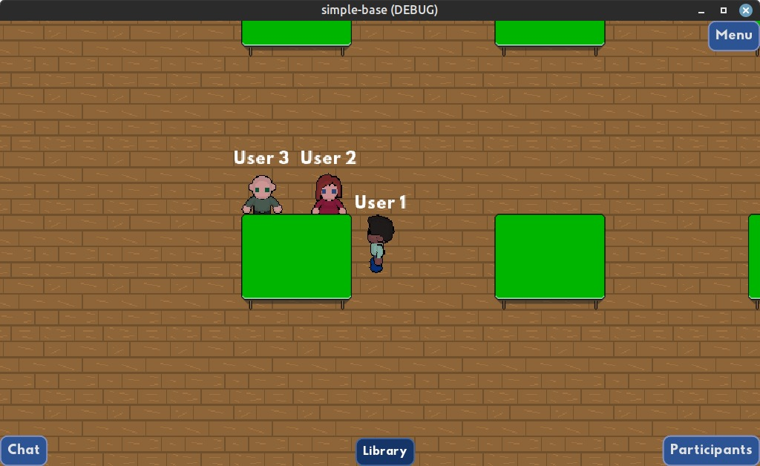

Space Design
Using TileMaps and Tileset
Library
THU
Office

Slide 23
Retrospective
What went well:
Similar project vision from the beginning
Willingness to work hard
Team availability to help
What went NOT so well:
Team communication
Slow start
Misinterpretation of tasks' complexity
What we can improve:
Try to think as a team, and not about only ourselves
Arrange meetings with urgency to not loose time
Break down complicated tasks to simpler ones
Notes:
Everyone vote what we can add here

Slide 24
Outlook – what could be done next
Add video chat/voice chat
Add pin boards to allow some sort of asynchronous interaction between users
Give the user the option to create its own space with an editor
Private spaces like a Webex Meeting Rooms
Extend the app to mobile
Add more spaces
More avatar designs

Slide 25
Thank you for listening!
Questions?

